Slide 1
Drug affecting on gastrointestinal function
The term gastrointestinal muscular tube that begins at the mouth and ends at the anus.
:Structure
Oral cavity
Esophagus
Stomach
Small intestine
Large intestine

Slide 2
Drug affecting on gastrointestinal function
Structures vary from
1. monogastric animals with simple stomach
2. ruminant animals with complex stomachs (Rumen,Reticulum,Omasum.Abomasum)
2. One control mechanism of the GI tract is the autonomic nervous system (parasympathetic and sympathetic branches)

Slide 3
Parasympathetic stimulation increases intestinal motility, increases GI secretions, and relaxes sphincters
Cholinergic drugs simulate these actions
Anticholinergic drugs inhibit these actions
Sympathetic stimulation decreases intestinal motility, decreases GI

Slide 4
Commen Disease for GIT
1.Constipation
2.Bloat
3.Gastritis
4.Gastrointestinal obstruction
5.Hemorrhagic Gastroenteritis
6.Inflammation of large intestine(Colitis)
7.Gastrointestinal Ulcers

Slide 5
Sialagogues
Sialagogues :
Drugs which increase the secretion of salivary gland .
It classified into two groups :
a-indirect action
b-direct action
a-indirect (reflexly) acting sialagogues :
acting on vagal nerve , the reflexes from the taste buds when stimulated cause increased secretion of saliva and gastric juice .

Slide 6
Bitters
Are classified into three groups :
1-aromatic bitters : include compound tincture of gentian , extract of orange peel and gentian powder .
2-simple bitters : like quassia .
3-compound bitters : like compound tincture of gentian and some alkaloids which have bitter taste e.g. quinine , strychnine and ipecacuanha .

Slide 7
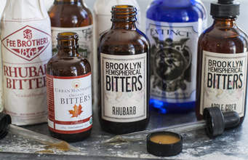

Slide 8
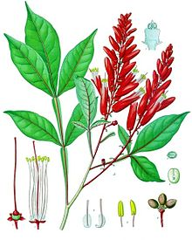

Slide 9
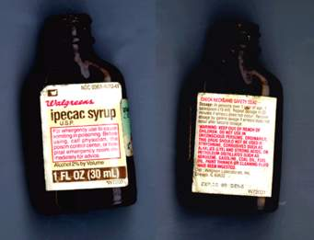

Slide 10
Bitters
b-directly acting sialagogues :
1-directing acting on parasympathetic .e.g. pilocarpine , physostigmine .
2-directly acting on secretary cells .e.g. potassium iodide , .
Na-salicylate .

Slide 11
Antisialagogues
Antisialagogues :
Drugs which either prevent salivation or depress salivation .
-e.g. tannic acid ( depress the secretary cell ).
-atropine (act on parasympathetic ) .

Slide 12
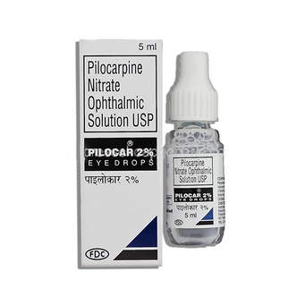
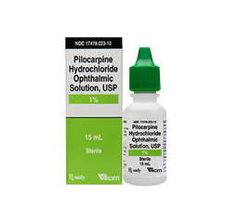

Slide 13
Appetizer ( appetite stimulants )
These drugs which stimulate appetite like vitamin B-complex , corticosteroid , anabolic steroids , nux vomica.
Indication : in case of anorexia .

Slide 14
Antacids
Antacids :
-they are drugs which neutralize part of the hydrochloric acid in the stomach .
-they are indicated in ulcer therapy , minor stomach irritations ,and other conditions depending on the type of antacid prescribed .these include :
Sodium bicarbonate :
I is used as a gastric antacid.

Slide 15
Antacids
Magnesium oxide :
-it is used as antacid and ( laxative )
-a side effect associated with mg . oxide is diarrhea .
Aluminum hydroxide and Magnesium :
-are used as a gastric antacid and as an agent in ulcer therapy .
-in ruminant are used to treat rumen acidosis .

Slide 16
Carminative
They are drugs which facilitate the expulsion of gas from the stomach or rumen . it's useful mainly in ruminant that produce large amount of gases during fermentation of carbohydrate , these gases are normally removed by belching but when this mechanism is disturbed , carminative are to be used :

Slide 17
Indication: bloat → gaseous bloat , frothy bloat .
e.g. volatile oil such as oil of turpentine , volatile drugs such as ether and alcohol and preparation ammonia .

Slide 18
Antizymotic
antizymotic :
drugs which kill or inhibit ruminal bacteria ,and prevent fermentation of carbohydrate and gas production
e.g. – formalin
- volatile oils
- antimicrobial : -tetracycline and streptomycin .
- copper sulfa to kill protozoa .

Slide 19
Emetics
Emetics :
Drugs which stimulate vomiting center .
-emetics can divided in to two classes according to the mechanism of action into :
1-central emetics( direct ).
2-reflex emetic ( indirect or local ).
1-central emetics :agents which stimulates the vomiting center in the medulla oblongata directly or indirectly through stimulation of the CTZ(Chemoreceptor Trigger Zone). Like Apomorphine

Slide 20
2-Indirect emetics : the agents that stimulate the sensory nerve ending of the vagel nerves in the stomach , duodenum and other organs , like : -Ipecacuanha a plant which contains the alkaloids emetine and cephaline , when given by mouth , produces emesis within 15 -30 min.

Slide 21
Side effect:lacremation ,conjunctivitis,increase bronchial secreation and sweating.
-Zinc and copper sulphate , when given 1%solution produce emesis within a few min. slowly absorbed , it's preferable drug in case of poisoning .

Slide 22
Antiemetic
Antiemetic :
drugs which prevent or alleviate nausea and vomiting . Indcation of anti emetics are typically used to treat motion sickness and the side effects of opioid analgesics , general anesthetics.Intestine obstraction,ureamia.

Slide 23
Antiemetic include :
-5HT5 receptor antagonists : these block serotonin receptors in the central nervous system and gastrointestinal tract . e.g. dolasetron.
-Dopamine antagonists :act in the brain and are used to treat nausea and vomiting associated with radiation sickness, opioids neoplastic disease(phenothiazine,Metoclopramide) .
-Antihistamine drug : including phenothiazine derivatives like promethazine , trimeprazine .
-anticholinergic drug : like hyoscine .

Slide 24
cholagogues
Cholagogues:
Drugs stimulate liver to secretion bile.substance which increase production of bile called choloretics agent e.g.bile salts.

Slide 25
Stomachic
Stomachic :
Drugs which stimulate the secretion of pancreatic enzymes in case of their deficiency .
1-tablets : known as pancreatin are used for this purpose , they are especially coated to resist digestion in the stomach and contain lipase , trypsin and amylase .
2-bile salts : passing in the duodenum cause the liberation of secretion , which stimulates pancreatic secretion .

Slide 26
The purgatives (laxatives ) :
are foods , compounds or drugs taken to induce bowel movements or to loosen the stool , most often taken to treat constipation .
-certain stimulant , lubricant , and saline laxatives are used to evacuate the colon for rectal and bowel examinations , and may be supplemented by enemas in that circumstance .
-

Slide 27
laxatives only work to hasten the elimination of undigested remains of food in the large
intestine and colon

Slide 28
Types of the purgatives
1-simple bulk purgative : eg.a.indigeatale fiber(pectin,cellulose).b.agar-agar japans sea weed it used in cat and dogs.
2-saline bulk purgative . e.g. – Mg sulphate , phosphate , oxide , carbonate ,powerful saline purgative . dangerous in case of horses .
-Sod. Sulphate , used for horses and cattle given by stomach tube because it has it undesirable taste .

Slide 29
3-lubricant ( emollient ) : .e.g. liquid paraffin .
4-irritant ( stimulant ) : .e.g. Castor oil , senna, rhubarb .
5-anionic purgative : . e.g. Dioctyl sod. Sulphosuccinate .
6-enemata : e.g. sodium chloride , soap and glycerin

Slide 30
Adsorbant
Adsorbant :
Are substances which stick to the surface of undesirable bowel contents like gases and poisons to protect the gut mucosa and facilitate removal of toxic substance .
e.g. kaolin (aluminum silicate ) , mg trisilicate , prepared chalk .

Slide 31
Astringents
Are drugs which precipitate proteins forming an insoluble layer on the mucous membrane , this layer protects the mucosa from irritation and inhibit exudation , secretion and small hemorrhage . astringents there are two types :
1-metallic astringents : like salts of iron and copper used intestinal astringent .

Slide 32
Salts of lead , zinc and aluminum used topically (in the skin)
2-vegetable astringents :
which act by liberating tannic acid precipitate proteins forming a protective layer forming
protective layer like catechu

Slide 33
Antidiarrheal agent
Antidiarrheal agents :
diarrhea can also be treated by the administration of preparation containing crude opium , such as tincture of opium or powdered opium in which the alkaloid morphine acts by increasing the tone of the intestinal muscle and delays the movement of digest along the alimentary tact

Slide 34
Antispasmodic
Antispasmodics :
drugs that used to relieve spasm by reducing intestinal motility also used to reduce the intestinal secretion.
Parasympatholytic :preparation of belladonna that contain atropine and hyoscine .
Morphine derivatives : e.g.diphenoxylate and loperamide.

Slide 35
Prokinetics
Prokinetics – stimulants :
Drugs increase the motility of a parts of the gastrointestinal tract.
This enhance the transit of material through the tract .

Slide 36
Prokinetics
dopaminergic antagonists :
Used in veterinary medicine include metoclopramide and domperidone ,
these agent stimulate motility of the gastro esophageal sphincter , stomach and the small intestine
-serotonergic drugs :
Cisapride is used in veterinary medicine . is stimulates
motility including the gastro esophageal sphincter ,stomach , small intestine and colon.
-Motilin – like drugs :

